Slide 1
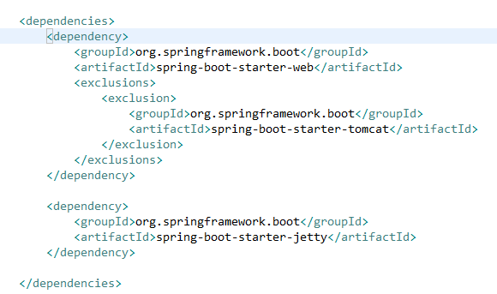
Spring Boot – Configure Jetty Server (Maven)
By default, Spring boot uses embedded tomcat server to run the application.
At times, you may need to use jetty server in place of tomcat server.
Spring Boot provides Tomcat and Jetty dependencies bundled together as separate starters to help make this process as easy as possible. You can use jetty with following simple steps.
You will need to update pom.xml and add dependency for spring-boot-starter-jetty. Also, you will need to exclude default added spring-boot-starter-tomcat dependency.

